Slide 1
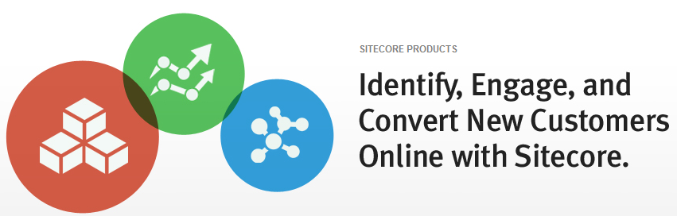
Enterprise Web Content Management intertwined with Digital Marketing Software
Alyssa Murphy, Sitecore
Kevin DiTroia, Sitecore

Slide 2
Identify, Engage, and Convert New Customers Online with Sitecore
Enterprise Web Content Management
& Integrated Marketing Software
Alyssa Murphy, Sitecore amu@sitecore.net
Kevin DiTroia, Sitecore kdi@sitecore.net

Slide 3
Agenda
Introductions
Goals
What are you looking for in a new CMS platform
What are you currently using?
What are the main aspects you want to change?
Sitecore Overview
Sitecore’s unique platform- what makes us different
Sitecore’s Engagement Platform
Demonstration
Ease of integration with various systems
Out-of-box localization capabilities (without integration)
Out-of-box (if possible) integration with localization partner like Translations.com or LionsBridge
Out-of-box (if possible) integration with Virage MediaBin
Out-of-box integration with cloud / CDN so that we don't have to write a bunch of custom code to refer to assets that we would like to be delivered to and sourced from the cloud
Out-of-box integration with existing .NET user controls, and ease of implementation of GUI approval workflows
Any functionality that delivers PDFs or other such document format onto a variety of form factors, including tablets or phones

Slide 4
Sitecore Company
Snapshot
Founded in 2001 with HQ in Copenhagen, Denmark
450+ Employees across 16 countries – Including China
3000+ Customers & 5000+ Certified Developers
Notes:
We are a private company but we have disclosed all of our financials on our website. We are a profitable and growing company, something we are very proud of.

Slide 5
Sitecore Company
Snapshot
Founded in 2001 with HQ in Copenhagen, Denmark
₂
450+ Employees across 16 countries – Including China
3000+ Customers, 5000+ Certified Developers powering over 40,000 websites
Notes:
Of the 450 employees, over half are in R&D. This is important in a technology space that is changing quickly. We only have one product, and half of the employees are developers for it. It speaks to the dedication of Sitecore to be leading edge and supports Gartner’s views that Sitecore is the MOST visionary company in our space.

Slide 6
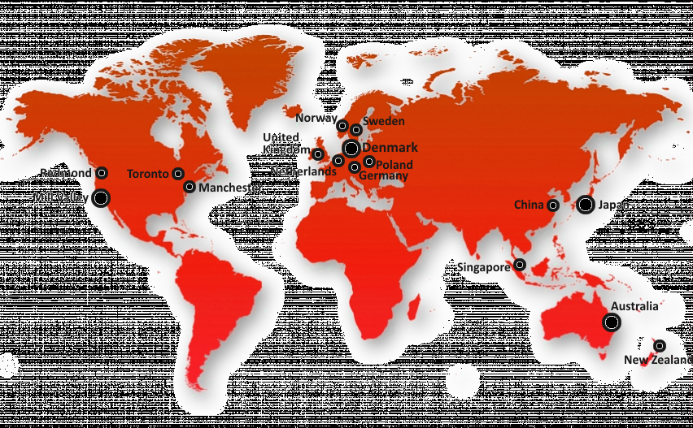
GLOBAL PRESENCE
With Over 450 Employees Around The World
Notes:
We have Sitecore employees on the Microsoft campus in Redmond. We are dedicated to the MS .net platform, we are a MS Gold partner and have a very symbiotic relationship with MS. MS runs several of their websites on Sitecore, and Bill Gates runs his personal website along with the Bill and Melinda Gates foundation website on Sitecore.

Slide 7
Sitecore Company
Snapshot
Founded in 2001 with HQ in Copenhagen, Denmark
₂
450+ Employees across 16 countries – Including China
₃
3000+ Customers, 5000+ Certified Developers powering over 40,000 websites

Slide 8









































Powering More Than 40,000 Websites

Slide 9














































Over 4,000 Customers and more than 42,000 websites

Slide 10
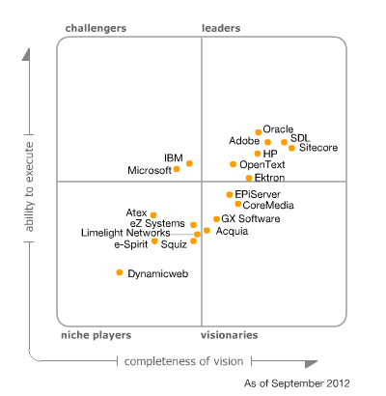
The Gartner Magic Quadrant for CRM Multichannel Campaign Management
Sitecore Strengths
Profitability
Digital marketing
Functional breadth
Aggressive road map
Integration flexibility and scalability
Sitecore enters this year's research as the Strengths
■ Sitecore usability remains strong in relation to challenging issues such as multilingual and multichannel requirements and the demand for more richly functional WCM environments tied to Microsoft SharePoint.
■ Sitecore demonstrates strong vision, with its Adaptive Print Studio enabling good continuation between online and offline experiences, and its work surrounding Engagement Analytics bringing good visibility to user interactions and campaign activity. Consider Sitecore when Web campaign management and the orchestration of campaigns for digital channels are priorities.
Notes:
I encourage you to talk to analyst if you have a relationship. All recommend that you take a look at Sitecore

Slide 11
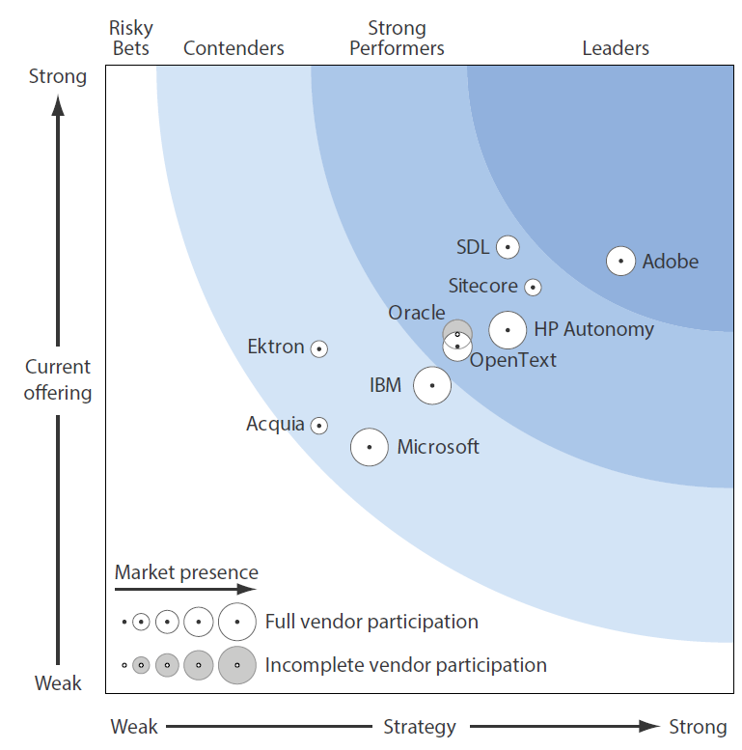
The Forrester Wave™: Web Content Management For Digital Customer Experience, Q2 2013
Sitecore takes the all-in-one approach to digital experience management with an offering that includes WCM and tools for analytics, marketing automation, email, mobile, eCommerce, and social. An advantage is that Sitecore specifically builds tools to be part of the same offering which have had to integrate acquired technology – so user experience is consistent and workflows are integrated.
Sitecore offers a broad set of functionality, so strategy and market momentum have become important differentiators.
Sitecore “focuses on core WCM plus DX innovation” and is the leading scorer among all vendors in the Engagement category, second overall for strategy and the third highest scorer overall.
The Forrester Wave™ is copyrighted by Forrester Research, Inc. Forrester and Forrester Wave™ are trademarks of Forrester Research, Inc. The Forrester Wave™ is a graphical representation of Forrester's call on a market and is plotted using a detailed spreadsheet with exposed scores, weightings, and comments. Forrester does not endorse any vendor, product, or service depicted in the Forrester Wave. Information is based on best available resources. Opinions reflect judgment at the time and are subject to change

Slide 12
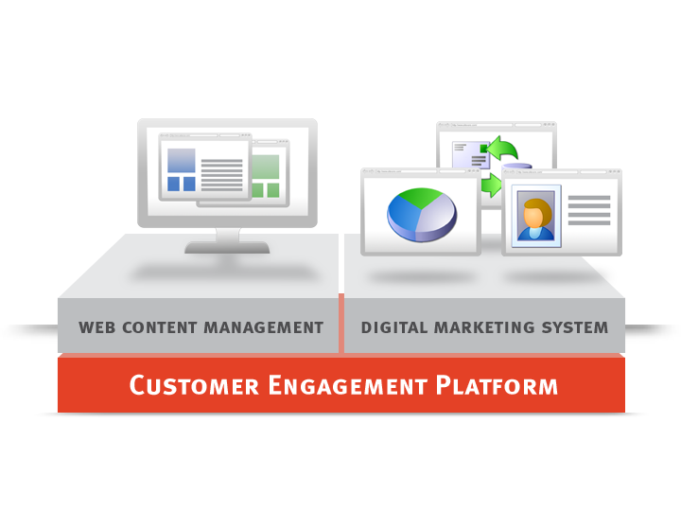
Sitecore Customer Engagement Platform (CEP)
Notes:
Help you to make more engaging websites!

Slide 13


Why use Customer Engagement Platform

Slide 14
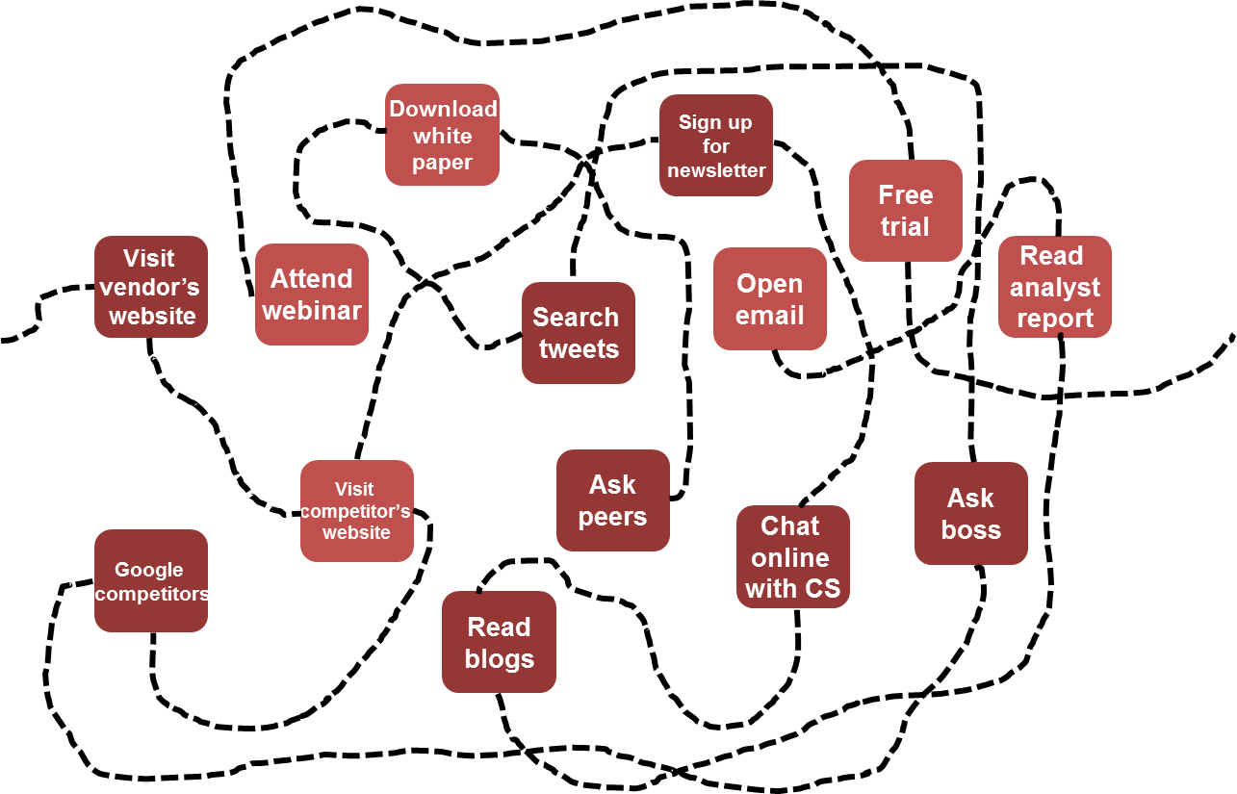

Coordinate the customer journey
Answer: systematically influence them at key touch points (the big steps and the little steps)
I want
to decide…
Done deal.
Notes:
I was excited – customers was excited, bought the License – but the solutions…..

Slide 15
Sitecore CEP
Snapshot
100% Build on Microsoft Technologies (.NET)
Support for all devices, channels and languages
Built in Analytics, Campaign Management & Automation

Slide 16
Sitecore CEP
Snapshot
100% Build on Microsoft Technologies (.NET)
₂
Support for all devices, channels and languages
Built in Analytics, Campaign Management & Automation

Slide 17
Sitecore CEP
Snapshot
100% Build on Microsoft Technologies (.NET)
₂
Support for all devices, channels and languages
₃
Built in Analytics, Campaign Management & Automation

Slide 18









In an average website Launch…
CMS is typically 1 of 8 tools employed….
Analytics
SEO
Personalization
Analytics
Content management
Lead scoring and
nurturing
Email marketing
CRM

Slide 19
True .NET application
Sitecore is built 100% on the .NET framework
No proprietary languages, just .NET.
True code neutral. Same application can be executed natively on both 32-bit and 64-bit versions of Windows.
API documented on exhaustive documentation site with more than 1500 articles, reference guides, code snippets,100+ open source controls.
No need to install COM Object, ActiveX controls, Windows services.
Everything you can do in .NET, you can do in Sitecore, e.g.:
Build your custom.NET security providers or .NET data providers.
Reuse ASP.NET controls from your existing solution or other code.
Reuse your SharePoint Web Parts.
Use any of the thousands web controls that are offered on the net.

Slide 20
Content based systems vs. page based systems
A page-based CMS allows you to edit the page in context. Each page is a separate unit which can be modified individually.
Benefits:
Conceptually easier to understand as it’s approach is similar to regular document editing.
A content-based CMS stores information as blocks of text, in Sitecore called Items. These individual items are related to each other to automatically build pages.
Benefits:
Handles larger volumes of content.
Efficiently reuses content throughout the system.
Has the ability to sort and filter information based on fields, e.g. faceted navigation and content personalization.
Ensures higher content and design consistency.
Strict separation between content and presentation ensures multiple-device output, e.g. for search engine optimization.

Slide 21
The Customer Journey Today
I want
to buy…
Download
white
paper
Sign up
for
newsletter
Free
trial
Visit
vendor’s
website
Attend
webinar
Open
email
Read
analyst
report
Search
tweets
Random Acts of Marketing
Visit
competitor’s
website
Ask
peers
Ask
boss
Chat
online
with CS
Google
competitors
How do I
decide?
Read
blogs
Notes:
People want to buy but they don’t know how to decide. There is no clear defined path. What Sitecore allows you to do is control the path for your prospects. Allows you to aggregate all this data in one place and allows you to converse with your prospects in an intelligent way.
Prospects are now in charge of the conversation they want to have with organizations. There are so many different ways in which you can communicate with your prospective clients (website, blog, email campaigns, white papers, etc) With Sitecore you can guide the conversations and personalize the delivery of your message to your prospective customers, in a way that will create a much higher engagement than was possible before.
Prospect Challenges
No memory of the last time we interacted
Mixed messages via different channels
Frustrating experience
This doesn’t answer my question
How did I end up here?
I’m not sure what to do next
That doesn’t make sense
I already told you that
The left hand doesn’t know what the right hand
is doing
Is this how they’ll treat me when I’m a customer?

Slide 22

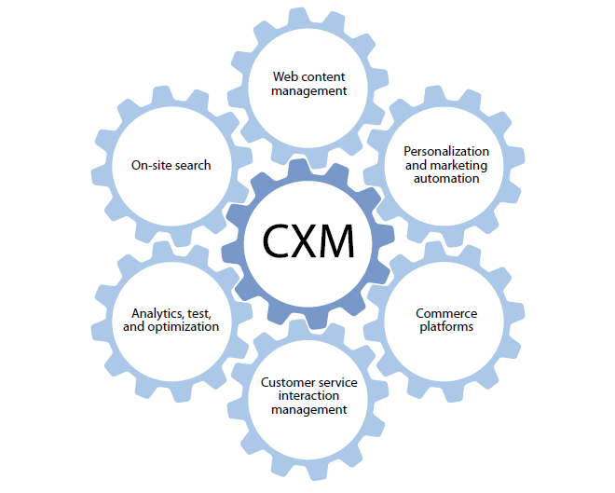
Customer Engagement
Customer Experience Management

Slide 23
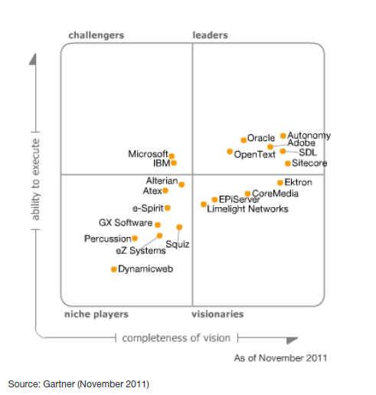
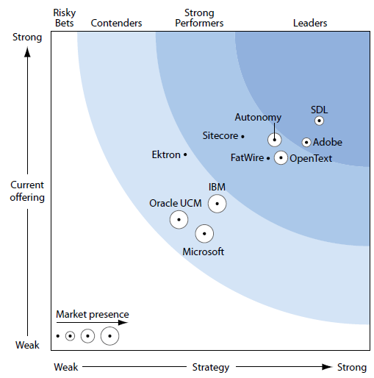
Customer Engagement
Sitecore in the Global Market
Gartner Magic Quadrant 2011
Forrester Wave 2011
“The Sitecore difference is providing measurable online business results
You need to know what you're doing, why you're doing it, and where your money is going.”
“Sitecore’s marketing tools, including campaign management, reporting, and e-forms (with CRM integration) differentiate it from many of its peers.”

Slide 25


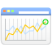



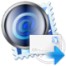





Sitecore Customer Engagement Platform
Goals & Engagement Values
Campaign Management
A/B split & MV testing
Sales enablement with CRM integration
E-mail campaigning
Engagement
Automation
Personas & profiling
Predictive personalization
Engagement Analytics
Inline Conditional Personalization
Cross Channel presence
Notes:
Where to start? There is low hanging fruit starting at the top in green. Really easy to get started and gain immediate results. Doesn’t have to go in this order but this demonstrates a logical progression when starting out. The vision can seem large but there are immediate wins.

Slide 26
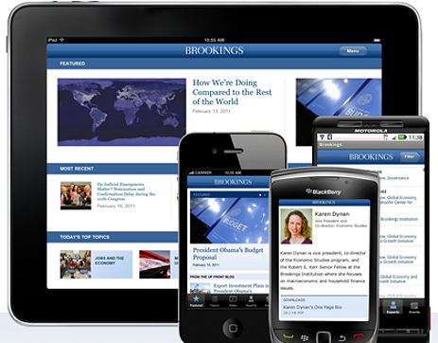
Mobile Ready Presentation Layer
Fully Support Mobile and Other Devices
Device Type (PC, IPad, Android, Email, Printer)
Content Delivery Conditions
Location
(Country, Prov., City, Postal Code)
Referrer
(Website, Campaign, Search Engine Keyword)
Visitor Profile
(Explicit or Implicit)
Notes:
A mobile optimized site is very different than a site that can be viewed on a Smartphone. 2012 is being hailed as the “year of the mobile”…again. It is important and necessary for Marketers to be able to build content once and be able to reuse this same content in mobile friendly versions. Sitecore solutions are able to detect when a site is accessed from a mobile device and automatically renders the appropriate version of the content.

Slide 27
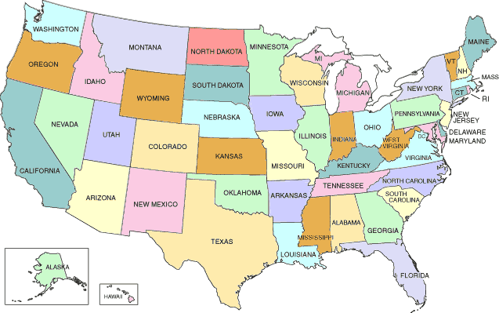
LOCALIZE WEB EXPERIENCES
Deliver Targeted Localized Content
Device Type (PC, IPad, Android, Email, Printer)
Content Delivery Conditions
Location
(Country, Prov., City, Postal Code)
Referrer
(Website, Campaign, Search Engine Keyword)
Visitor Profile
(Explicit or Implicit)
Notes:
With Sitecore, we utilize Maxmind GeoIP services that give your longitude and latitude informtion about each visitor to your website.

Slide 28










Recognize Where Visitors Come from
Align visitor web experiences with what they want
Social Media
Device Type (PC, IPad, Android, Email, Printer)
Content Delivery Conditions
Organic Search & PPC
Location
(Country, Prov., City, Postal Code)
Email Marketing
Referrer
(Website, Campaign, Search Engine Keyword)
Visitor Profile
(Explicit or Implicit)
Advertising Campaigns
Notes:
Sitecore allow you to determine where your visitors are coming from, and allows you to deliver content that will personalize their experience.
Did they click on an email link from a campaign? Did they access your site from Yahoo or Google? Was it a generic search or did they already know your brand? What browser did they use to reach your site? If they are coming from Safari, perhaps you display higher-end options on your site.
All of this information will determine what content is delivered to individual visitors?

Slide 29
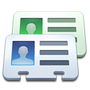

Organic Profiles-dynamic personalization
SITECORE TAKES PERSONALIZATION TO ANOTHER LEVEL
Explicit Profile
Device Type (PC, IPad, Android, Email, Printer)
Content Delivery Conditions
Member Profile Data
CRM Profile Data
Location
(Country, Prov., City, Postal Code)
Referrer
(Website, Campaign, Search Engine Keyword)
Implicit Profile
Visitor Profile
(Explicit or Implicit)
Browsing Behavior –
Preferences \ Interests
Notes:
Sitecore allows you to build visitor profiles based on information gathered during the web journey of prospective customers. Based on the information gathered, you are able to set up personas that will help guide the experience for your otherwise unknown visitors. Based on what content is read, how they arrive at your site, what interests they have on social sites, what products they currently use, you are able to put a value on each visitor. You are then able to deliver the most relevant content to your visitors resulting in a higher engagement.
Digital footprint- how you got there
Digital fingerprint is information you have provided us

Slide 30
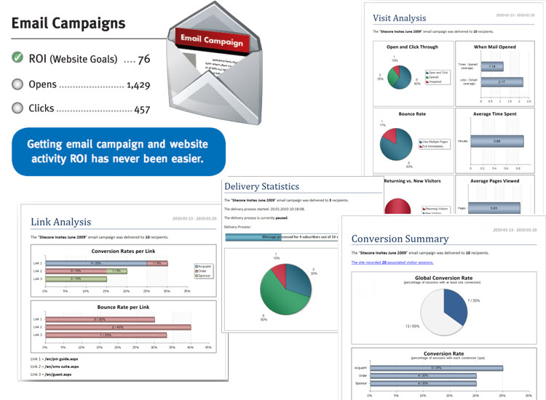
You’ve Got Mail?

Slide 31

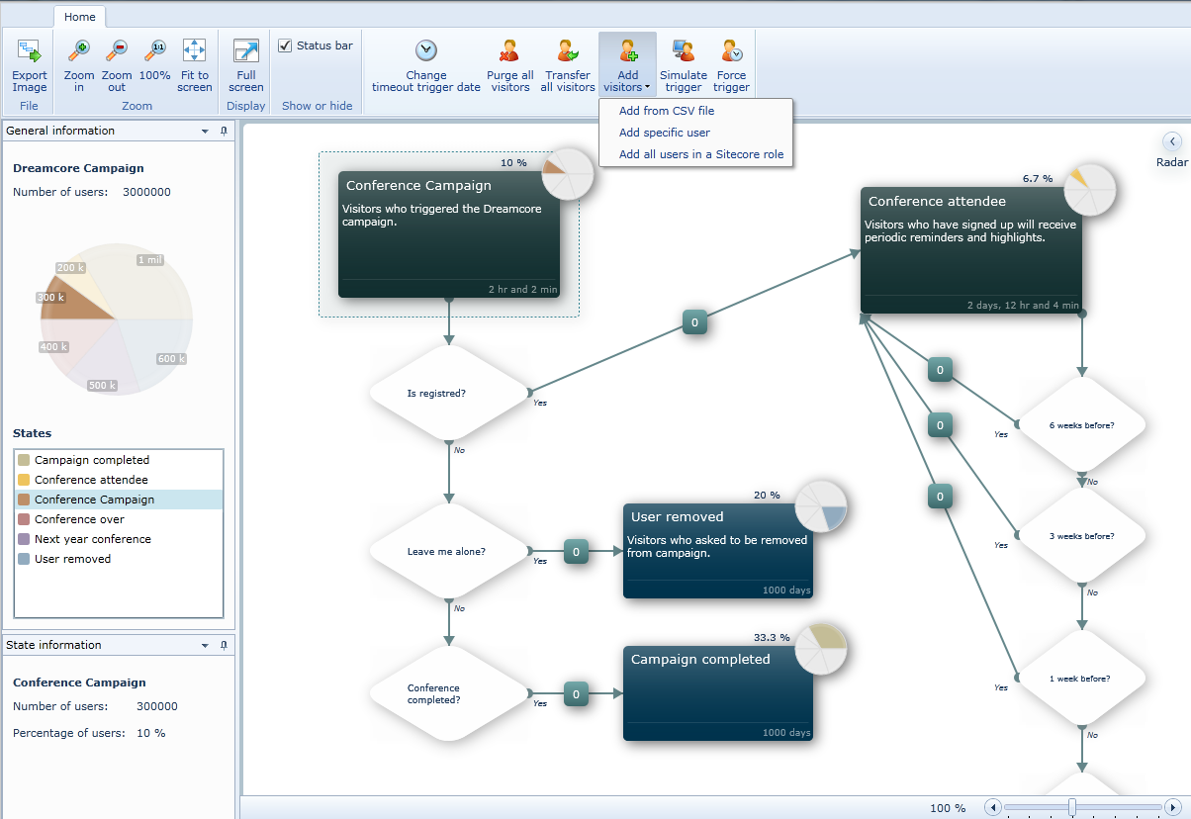
Engagement Automation

Slide 32
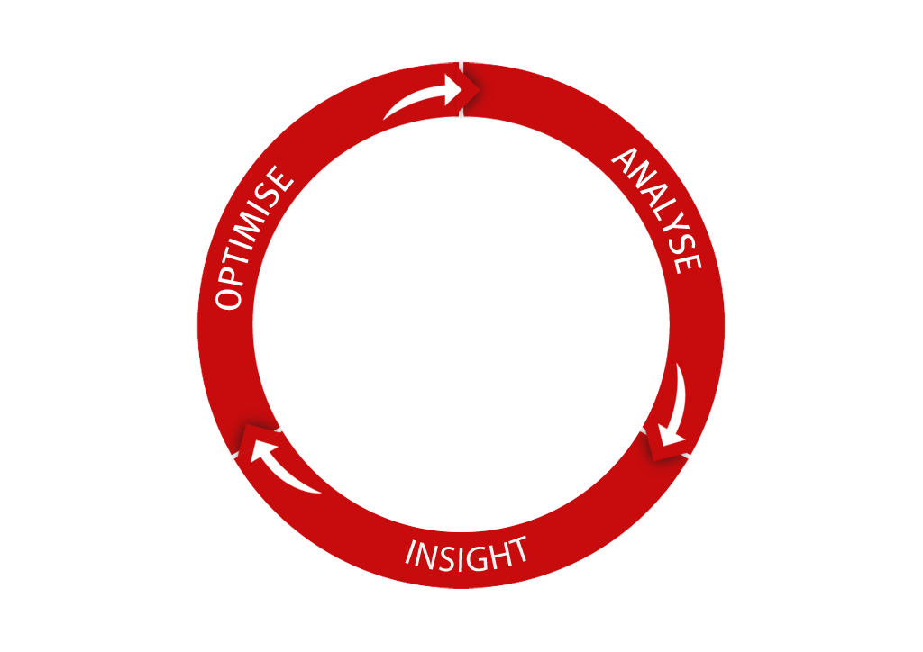


Analysis, Insight & Optimisation
discover
Track value across campaigns and channels
Develop insight into digital marketing effectiveness
Optimise content, behaviour and spend to maximise results
CONTENT
ACTION
VALUE
understand
nurture
respond

Slide 33
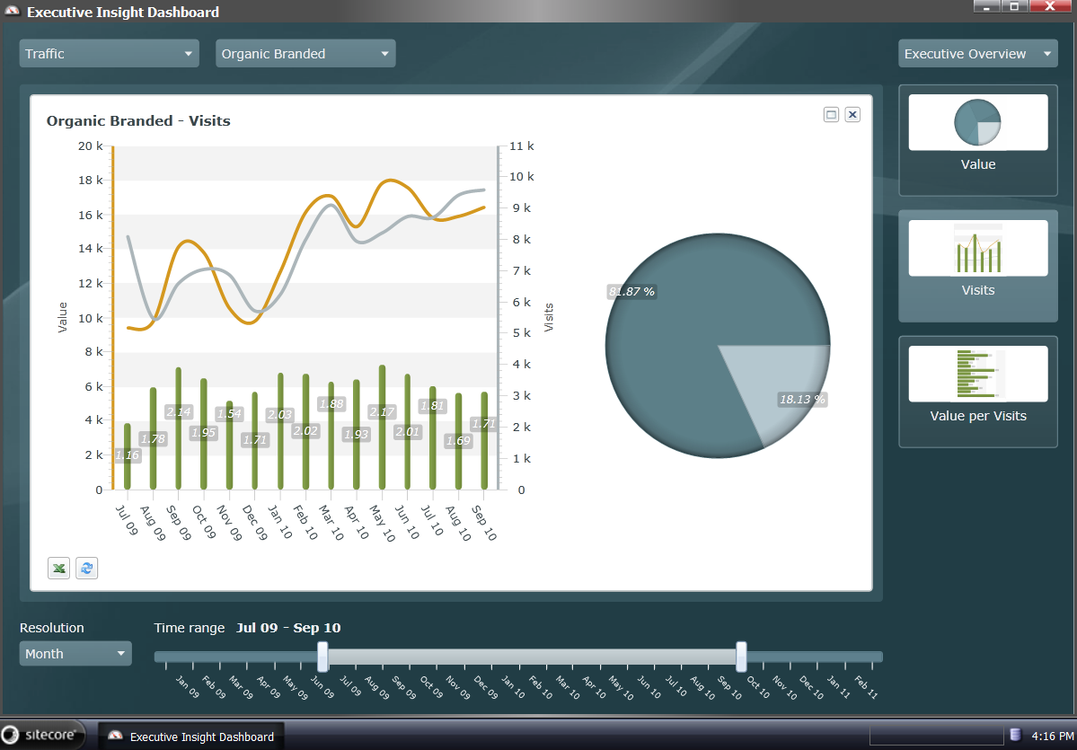
Executive Insight Dashboards

Slide 34
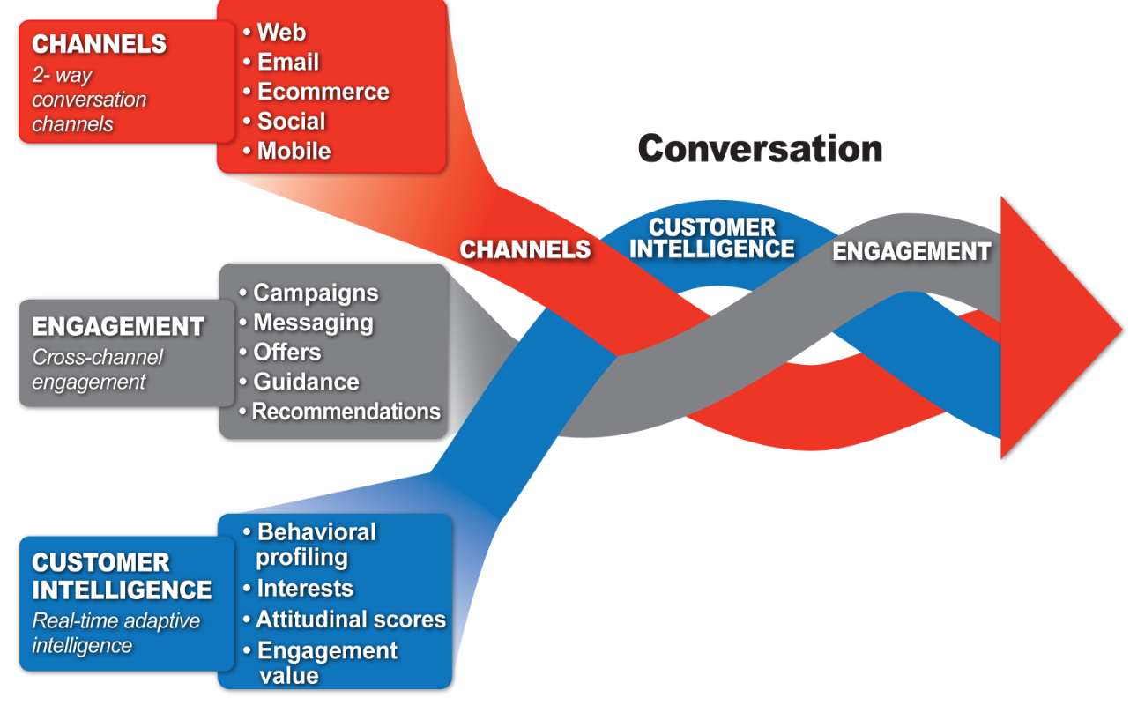
Notes:
Sitecore’s vision for is that we give you the ability to weave together your many interactions with your customers, you engage, while gathering and applying customer intelligence at every step. Weaving these three things together creates the conversation, and leads to a deeper customer relationships.
I’d love it said interactions rather than channels, and simply “intelligence”. Interactions should include offline

Slide 35
Key points to consider
Content based CMS
No pages
Dynamic assembly and personalization
Separation of content from presentation
Content items presentation customized to variable triggers:
Device
Channel
Referrer
GeoIP
Developers Platform
Open Pipeline – completely customizable
ASP .NET/MVC/Web Services/API
One common code platform across all modules
Foresight and vision to develop an integrated DMS and CMS-Analytics platform
R&D Investment
60+% and over 220 developers working this platform daily
Roadmap is “Most Visionary” according to Gartner

Slide 36
Demo

Slide 37
Sitecore CMS
Technical Overview
Chris Castle, Solution Architect
chc@sitecore.net

Slide 38
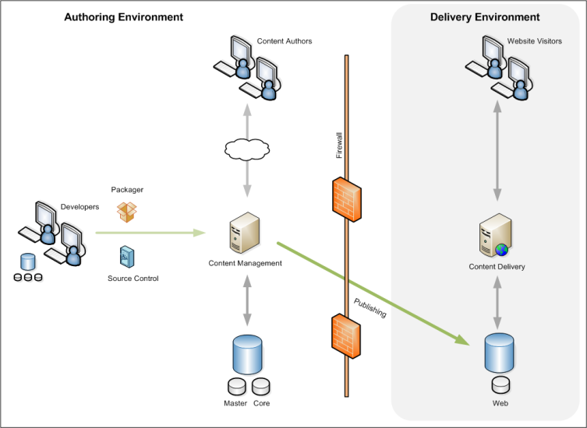
Typical Sitecore Deployment
Notes:
This checklist briefly shows that Sitecore uses common web development standards.

Slide 39
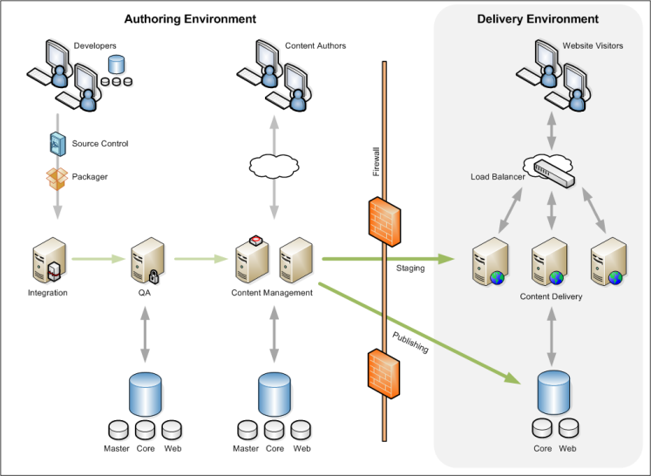
Typical Sitecore Deployment
Notes:
This checklist briefly shows that Sitecore uses common web development standards.

Slide 40
Content

Slide 41
Five Steps To Create a Sitecore Site
Content
Create Data Templates
Create Content Items
Presentation
Create Layouts
Create Controls
Bind
Template Standard Values
Presentation Layout Details
5
3
1
4
2
Notes:
Let’s go over the steps and tools we will be using to create A Very Simple Website.

Slide 42
Content Terminology: Data Template
Data Templates
The data structure and framework around which items are built.
Fields
Individual components of a Data Template where data entered into the system is controlled.
Field Types
Determines the manner in which data is entered or selected for fields.
Inheritance
Data Templates can inherit from other templates
Notes:
Templates — Sitecore users create items using one of three template types: data templates, branch templates, and command templates. Data Templates form the framework around which items are built. They define fields used to control how data is entered and can inherit from other templates to enable reuse.
Fields — these are the areas within which the data entered into the system is controlled. Through these fields, grouped into Sections, we can organize and control the amount and type of data entered into the system. Fields are organized by their field type.
Field Types — these are the different ways through which data is entered or selected for fields. There are numerous flexible ways of entering data into the system and it is the field types which control the type of data that can be entered or selected in the fields.
Data is validated throughout the system. The different types of validation are discussed and we will describe how validation covers the entire data definition area within the system to control the validity and authenticity of data definition structure.
You can use standard values to ensure that default data is automatically inserted into newly created items. Standard values are default values that populate null fields of existing items or fill data into newly created items.

Slide 43
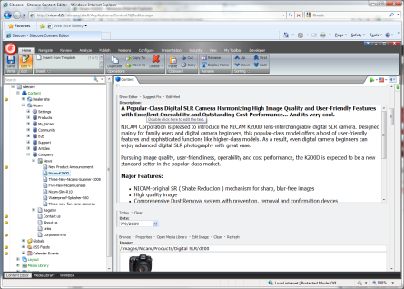
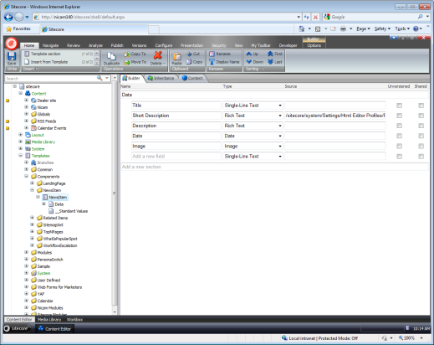
Content – Template Manager

Slide 44
Presentation

Slide 45
Five Steps To Create a Sitecore Site
Content
Create Data Templates
Create Content Items
Presentation
Create Layouts
Create Controls
Bind
Template Standard Values
Presentation Layout Details
5
3
1
4
2
Notes:
Let’s go over the steps and tools we will be using to create A Very Simple Website.

Slide 46
Presentation Component Terminology
Layout
Defines the overall appearance of a page
Consists of:
A Layout Definition Item stored in the Content Tree
A .NET ASPX file stored under the Web root
Sublayout
Defines the appearance of an area of a page
Consists of:
A Sublayout Definition Item stored in the Content Tree
A .NET ASCX file stored under the Web root
Placeholder
A named location on a layout or sublayout
Used to associate controls to a given location for a given item
Notes:
It’s time for a formal introduction to Sitecore’s most common presentation components.
A layout defines the overall appearance of a page and consists of both a definition item in the Sitecore Content Tree and a .NET ASPX file stored in the Web root. The definition item, among other things, indicates the name and location of the associated ASPX file.
A sublayout defines the appearance of an area of a page and consists of both a definition item in the Sitecore Content Tree and a .NET ASCX file stored in the Web root. The definition item, among other things, indicates the name and location of the associated ASCX file.
Placeholders are special components that developers use to make a layout or sublayout reusable for many different types of items. The placeholder specifies a location on the page where control(s) can be added as the page is built for a specific item.

Slide 47
Presentation Component Terminology
XSLT Renderings
Transforms content to presentation using XSL Templates
Consists of:
An XSLT Rendering Definition Item stored in the Content Tree
An XSLT file stored under the Web root.
We will work with XSLT Renderings later today
Sitecore Web Controls
Transforms content to presentation using .NET code
Control
Generic term for anything we can add to a layout or sublayout
NOTE: As normal in any ASP.NET application, use source control for files!
Notes:
We use the term “control” to refer generically to sublayouts, XSLT renderings, Sitecore Web controls, and other constructs that can we can add to a layout or sublayout either statically or using placeholders.
Note that this means that a sublayout is also considered a control.
Two common controls include XSLT Renderings and Sitecore Web controls. In this course, we will learn how to use XSLT Renderings. Sitecore Web controls are covered in the Web Site .NET Developer course.

Slide 48
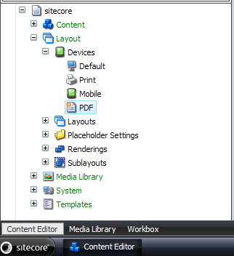
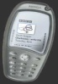
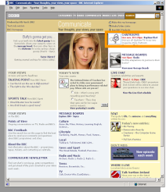
Presentation Component Terminology
Device
A logical entity that may send HTTP requests to the site
For example:
A Web browser like Internet Explorer, Firefox, or Safari
A printer (or a Web browser preparing to send a page to a printer)
A mobile device
An RSS reader
Used to differentiate how to format the page for a given item
Developers may choose different layouts and sublayouts for each device
Sitecore detects the device using either:
Query strings
Known browser agent strings
Custom .NET logic
Rules Engine
Notes:
Sitecore also uses the concept of a “device”, which is a logical construct that represents an entity making an HTTP request to the site.
When developers specify which layout and dynamic controls to use for an item, they provide information for each device that the page is expected to support.
Sitecore can detect which device a visitor is using based on a variety of criteria.

Slide 49
Template Standard Values
Template
Standard
Values
Default Values
Workflow
Presentation Layout Details
Insert Options
Default Values
Static
Dynamic – e.g., $name
Insert Options
Allows a business user to create new content
Presentation Layout Details
This is a Recommended Best Practice!
Workflow

Slide 50
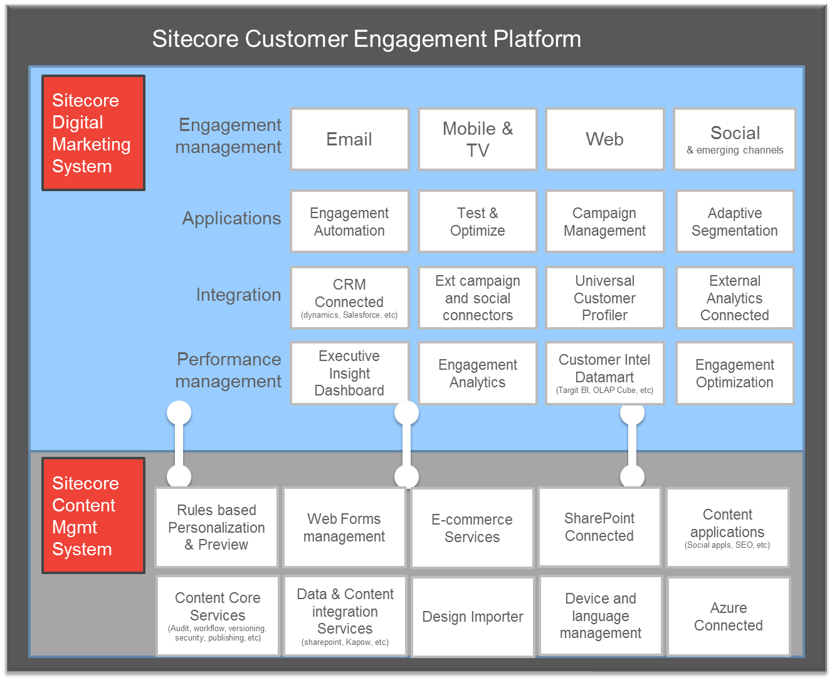
Notes:
So that is what we’ve got planned for next year. As you can see, we’re going to be busy. Building on our Content Management system, the Digital Marketing system truly enables Customer Engagement. When you look at what you can now achieve with Sitecore, it’s no wonder our customers have some of the best websites in the world. I look forward to working with many of your in the coming year, thanks for being our customers and partners.

Slide 51
Technology Checklist
Technology | Description | Check
.NET | Microsoft .NET Framework | ✓
Web Services | XML, SOAP (Simple Object Access Protocol) | ✓
ASP .NET 2.0 | Better, faster, more stable | ✓
XML | eXtensible Mark-up Language | ✓
XAML | eXtensible Application Markup Language (XAML) | ✓
XSLT, XPath | XML Transitions | ✓
SOAP | Object interoperability | ✓
UTF-8 | W3C I18N - Internationalisation | ✓
Devices | W3C device independence working group | ✓
W3C/WAI | WCAG, ATAG Accessibility standards | ✓
AJAX | Asynchronous JavaScript and XML | ✓
RSS | Really Simple Syndication | ü

Slide 52
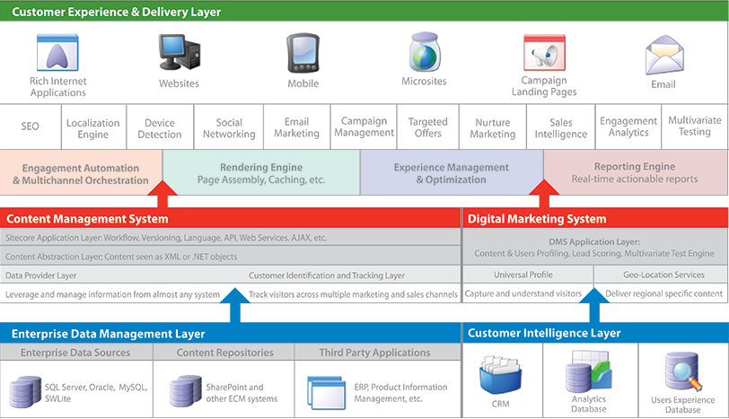

Slide 53
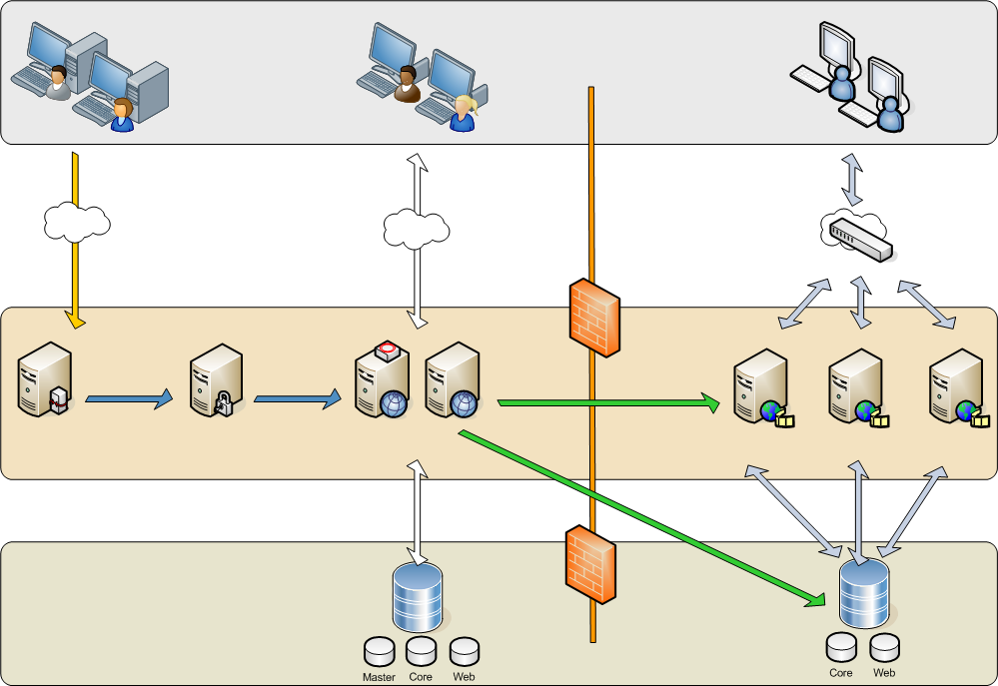
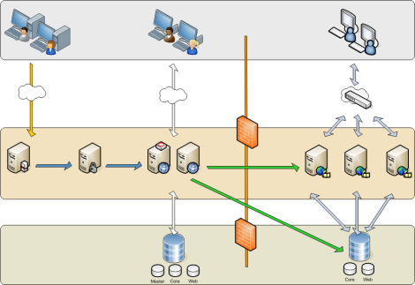
Multi-Server
Editing Environment
Runtime Environment (DMZ)
Users
Developers
Content Authors
Website Visitor
Developers upload work through Packages (with Source Control)
Content Authors modify content
Visitors request Website
Firewall
Network Load Balancer
Servers
Packages
Packages
Staging
Integration
Servers
QA
Servers
Content Management
Servers (CM)
Publishing
Content Delivery Servers (CD)
Sitecore
Databases
Notes:
This diagram represents a typical Sitecore deployment. The content management server is located within the firewall (along with a failover server). In addition, developer workstations, an integration server and QA server(s) are all located within the firewall. In the DMZ, content is delivered from a load-balanced web farm.
We will discuss this configuration more in the following slides.
Items and files need to move among the servers. We will cover content promotion tools to move items and files in the following slides, also.

Slide 54
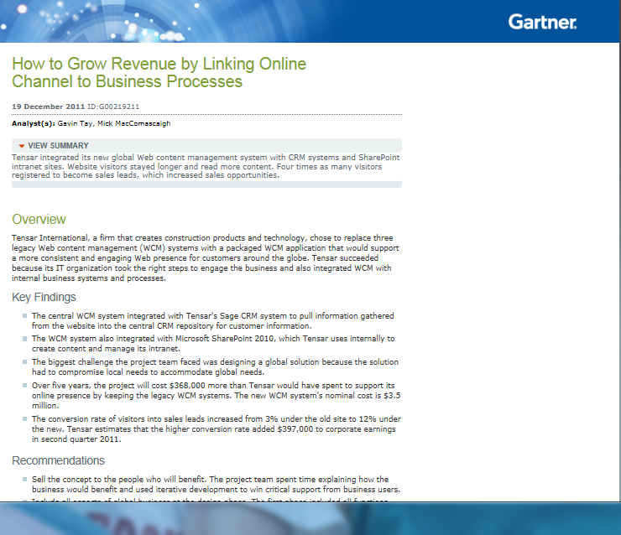
How to Grow Revenue by Linking Online Channel to Business Processes
"This increased engagement by website visitors has led to increased conversion of sales leads... The conversion rate of visitors into sales leads increased from 3% under the old site to 12% under the new. Tensar estimates that the higher conversion rate added $397,000 to corporate earnings in 2Q-2011, compared with the quarter a year ago.“
Read the full document here:
http://www.gartner.com/technology/reprints.do?id=1-18TSGZW&ct=120117&st=sb
How to Grow Revenue by Linking Online Channel to Business Processes
Published: 19 December 2011 ID:G00219211
Analyst(s): Gavin Tay | Mick MacComascaigh

